Slide 1
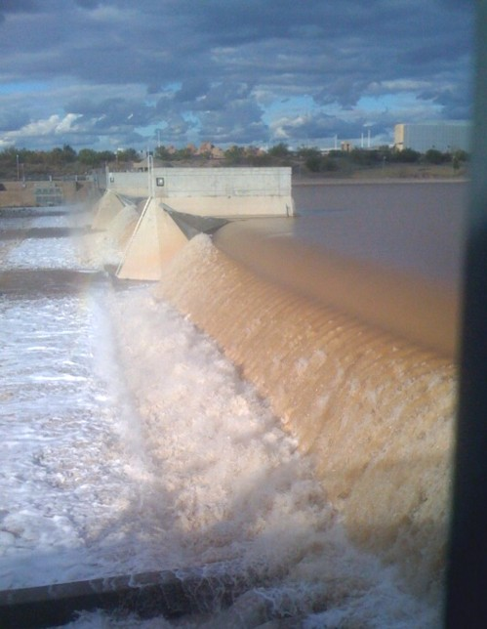
Biogeochemistry of Tempe Town Lake
Lauren Puglisi

Slide 2
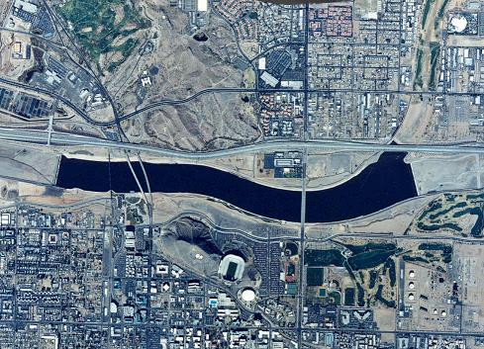
Introduction To Tempe Town Lake
Manmade lake
Built for flood control and recreational purposes
Today, Tempe Town Lake is home to boating, fishing, biking, and more
Tempe Town Lake is a good model for understanding larger reservoir systems, such as Lake Powell
Map of Tempe Town Lake
Tempe Town Lake
http://www.kam-az.com/tempe%20town%20lake.jpg

Slide 3
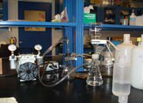
Sampling Tempe Town Lake
Objective: determine seasonal variations in the chemistry of Tempe Town Lake
Method: sample Tempe Town Lake twice a week
Test the samples for Dissolved Organic Carbons, pH, Dissolved Oxygen, Alkalinity, and Conductivity
Filtration System
Kelly and Hartnett

Slide 4
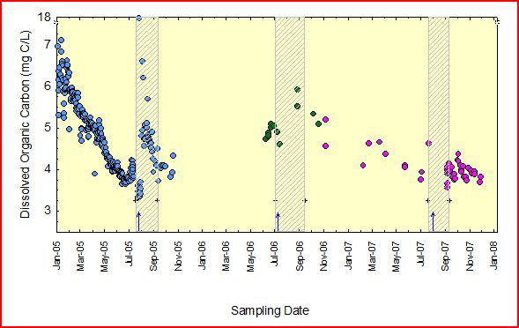
Dissolved Organic Carbon (DOC)
Dissolved Organic Carbon Concentrations
Seasonal variations have been observed
DOC levels tend to “spike” during precipitation events

Slide 5
Conductivity
Decreases with rain events
Evaporation plays a role in conductivity levels

Slide 6
Dissolved Oxygen
Varies seasonally
Multiple factors appear to be involved

Slide 7
pH
Tends to remain fairly constant

Slide 8
Alkalinity
Appears to be strongly influenced by temperature
Decreases when temperatures are cool, and increases when temperatures are warm

Slide 9
Recent Weather Events
Increased Precipitation in January 2010
The increased rain fall and river flow necessitated the lowering of the inflatable dams
Conductivity Concentrations Decreased
Sampling was increased to investigate the effects of precipitation on the biogeochemistry of the lake.

Slide 10
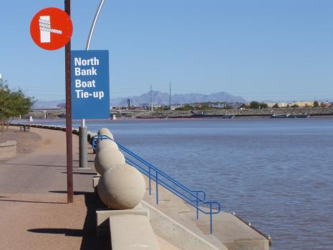
Questions
http://www.phoenix-valley-real-estate.com/images/Tempe%20Waterfront%20Condos%20007.jpg

